Slide 1
Data Modeling Concepts Part 1
<Data Model 101 Series>
Anand Kumar
Notes:
Hello friends
I am Maheeja, and today I shall take you through one of the key elements of a data-warehouse, what is called a data model. We have put together few concepts that will explain you all about it. At the end of this session, you would get a fair idea of what data modeling is and a bit on its role in Business processes.
We shall begin our session with an overview of data modeling.
© 2009 Wipro Ltd – Internal & Restricted
‹#›

Slide 2
Data Modeling Overview
A method by which the enterprise business model is defined in terms of data elements and the relationships existing among those data elements.
Provides data view of the business model in a graphical representation of data elements as entity sets and business rules as relationships lines connecting the entity sets.
The data modeling details are covered in three parts,
Part 1 – Introduction to Database System and Context of Data Modeling.
Part 2 & 3 - Data Modeling terms and concepts and Data Modeling in Data Warehouse environment.

Slide 3
Data Modeling Objectives
Upon completion of this module you will be able to:
Understand What is Database Systems
The importance of Data Model
How the Data Model is developed from business model

Slide 4
Data Modeling Outline
Lesson 1 Introduction to Database Systems
Lesson 2 Context for Modeling

Slide 5
Introduction to Database Systems

Slide 6
Introduction to Database Systems
Data
A known fact that can be recorded and that have implicit meaning
Database
A collection of related data with the following implicit properties
A database is a logically coherent collection of data with some inherent meaning
A Database is designed, built, and populated with data for a specific purpose

Slide 7
Introduction to Database Systems
Database Management System (DBMS)
A collection of programs that enables users to create and maintain a database
A general purpose software system that facilitates the process of defining, constructing and manipulating database for various applications
Database System
A collection of programs that enables users to create and maintain a database
data stored as database

Slide 8
Introduction to Database Systems
Users / Programmers
Database System
Application Programs / Queries
DBMS Software
Software to Process Queries / Programs
Software to Access Stored Data
Stored Database Definition (Metadata)
Stored Database

Slide 9
Introduction to Database Systems
Model
Representation of a set of business requirements in a standard structured framework understood by the users
Data Model
A collection of concepts that can be used to describe the structure of a database
Most data models include a set of basic operations for query and updates on the database

Slide 10
Introduction to Database Systems
RDBMS
It is a system in which, at a minimum :
The data is perceived by the user as tables (and nothing but tables )
The operators at the user’s disposal - e.g., for data retrieval - are operators that generate new tables from old, and those include at least SELECT, PROJECT, and JOIN
Features of an RDBMS
The ability to create multiple relations (tables) and enter data into them
An interactive query language
Retrieval of information stored in more than one table
Provides a Catalog or Dictionary, which itself consists of tables (called system tables)

Slide 11
Context For Data Modeling
Business Enterprise, Overview

Slide 12
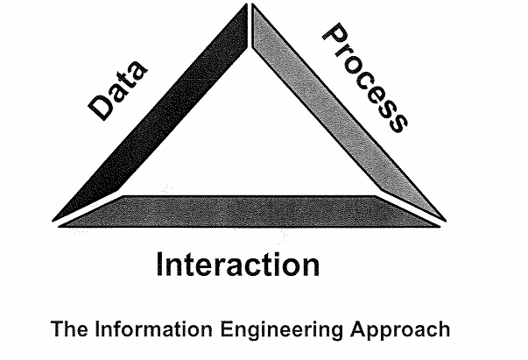
Context for Data Modeling
A model-based approach to business rule definition and systems development considers data and processes requirements and how those requirements interact with one another.
This is an information Engineering (IE) based approach.

Slide 13
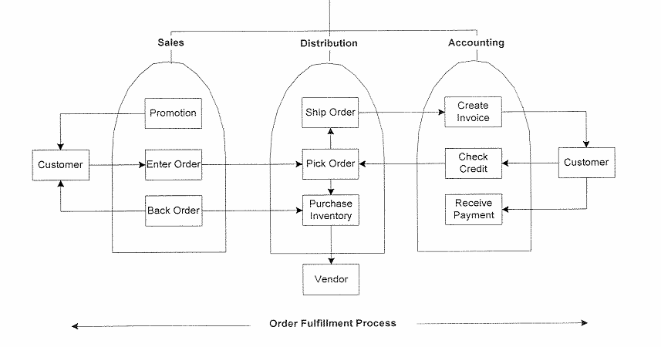
Business Enterprise - Process View
The focus of the process view is to define how the business operates, and it includes activities and dependencies that comprise process-oriented business rules.
It crosses organizational boundaries and includes external entities to depict how an organization conducts business.

Slide 14
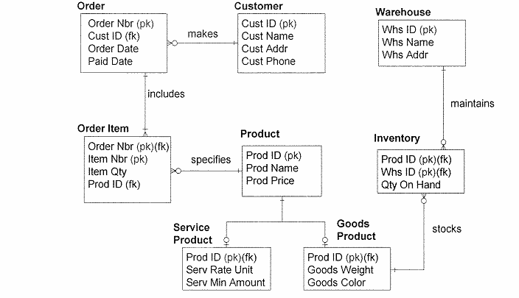
Business Enterprise – Data View
The focus of the data view is to define what information the business needs to support itself.
This includes category and detailed information that comprise data-oriented business rules.

Slide 15
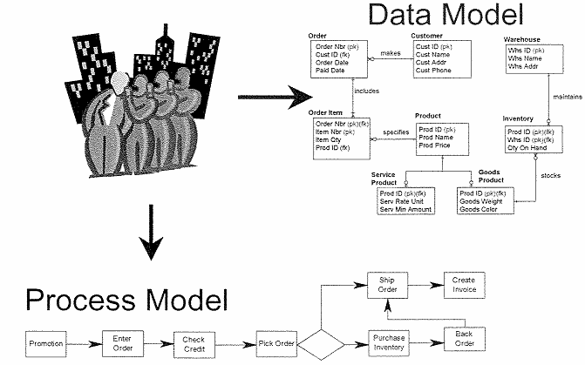
Business Enterprise Overview
Process modeling and data modeling each view the same business reality from different perspective. Separately each has values and omissions.
Together they form a clear picture of an enterprise or system.

Slide 16
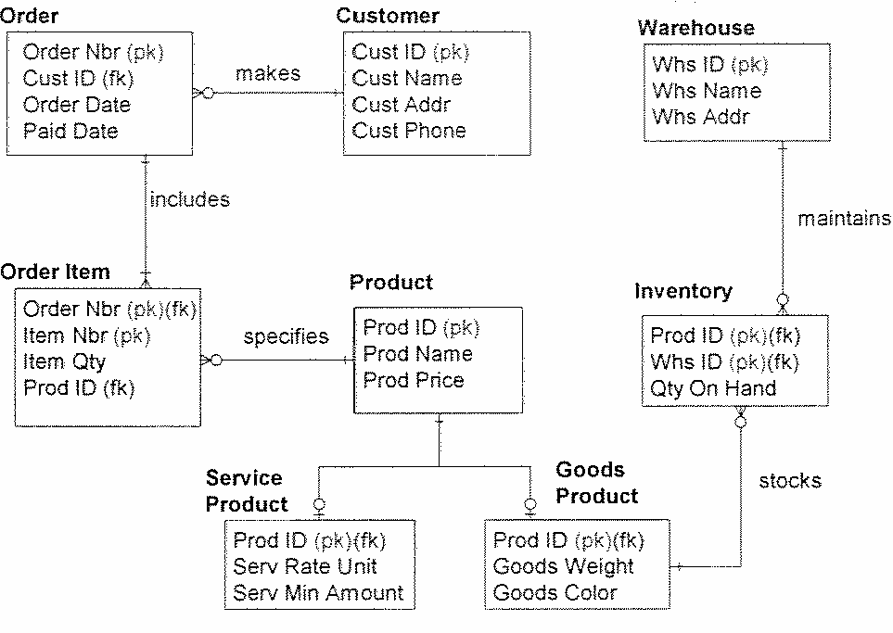
Data Model Overview – Role in Business
The What not How of business
Strategic, Tactical or Operational View
Responsive to Change

Slide 17
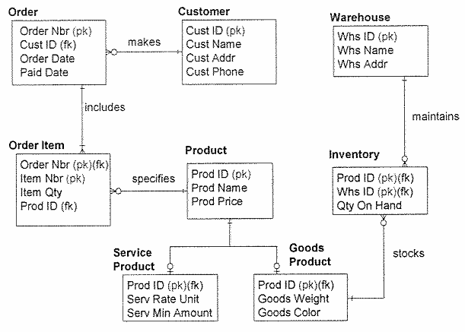
Data Model Overview - Characteristics
Graphical picture of:
The things a business cares about
How they relate to each other

Slide 18
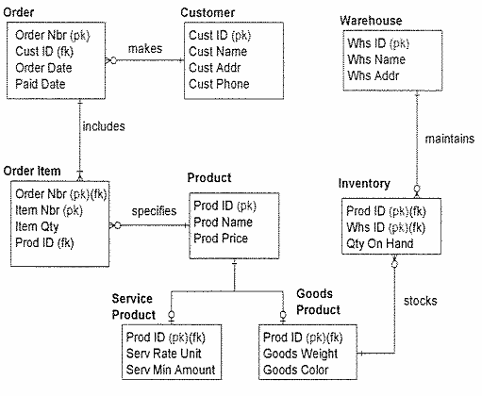
Data Model Overview – Characteristics Contd..
A “model” that is:
A single representation of the information required by all user-views of the enterprise.
Built and rebuilt until it represents real-life data structures

Slide 19
Module Summary
Congratulations! You have now completed the 1st Part of the module Data Modeling Concepts.
You should now be able
What is Data
What is Data Model
What is Database Management System
The characteristics of Data Model

Slide 20
Quiz

Slide 21
Question 1
Which of the following form the clear picture of the Enterprise business?
Data view only
Process View only
Data View and Process view together
None of these

Slide 22
Question 1
Which of the following form the clear picture of the Enterprise business?
Data view only
Process View only
Data View and Process view together
None of these
Answer: C

Slide 23
Question 2
Which is not the Feature of RDBMS:
The ability to create tables
Provide a Query language
Provide a catalogue or Dictionary
Data Profiling capability

Slide 24
Question 2
Which is not the Feature of RDBMS:
The ability to create tables
Provide a Query language
Provide a catalogue or Dictionary
Data Profiling capability
Answer: D

Slide 25
Question 3
Which one is correct
The data model provides a relation between data and processes of a business
The data model provides a relation between data and department of a business
The data model provides a relation between department and department of a business
The data model provides a relation between process and department of a business

Slide 26
Question 3
Which one is correct
The data model provides a relation between data and processes of a business
The data model provides a relation between data and department of a business
The data model provides a relation between department and department of a business
The data model provides a relation between process and department of a business
Answer: A

Slide 27
Question 4
Which one is correct
The data model converts business process into data model
The data model converts business rule into data model
The data model converts business data into data model
The data model converts business location into data model
Notes:
Now we come to the second part of the module - Context For Data Modeling
Data Modeling integrates the data and the process of an enterprise. A Data model is developed in the context of business processes of an enterprise.
It has to represent the business process in terms of data structures and business rules.
In this part of the module, we shall cover :
-Process View of a business process,
-Data View of the business process,
-Data Model Roles and Characteristics.
© 2009 Wipro Ltd – Internal & Restricted
‹#›

Slide 28
Question 4
Which one is correct
The data model converts business process into data model
The data model converts business rule into data model
The data model converts business data into data model
The data model converts business location into data model
Answer: A
Notes:
Data Modeling provides a way to integrate data and business process.
The Information Engineering Approach suggests that there should be a model and the model should consider the interaction of data and process.
Before the model is developed, the business process view has to be present. The data model is developed from the business process view.
This is explained in next few slides.
© 2009 Wipro Ltd – Internal & Restricted
‹#›

Slide 29
Question 5
Which is not a characteristic of data model
It provides a user view of business model
It provides a graphical view of business model
It is built and rebuilt until it represents a real life data structure
It provides a textual view of business model

Slide 30
Question 5
Which is not a characteristic of data model
It provides a user view of business model
It provides a graphical view of business model
It is built and rebuilt until it represents a real life data structure
It provides a textual view of business model
Answer: D
Notes:
The database system primarily deals with data.
Let us understand what is data.
Data is a known fact that can be recorded and that has implicit meaning.
for e.g. an employee data would be:
Name: Ram,
Location: Delhi,
Date of Joining: 01/01/2001
Skills: Oracle, Java
Current project: Order management system
This is raw data and it contains lots of information of an employee. If the complete information about each employee is stored in such form, then it is difficult to present and maintain. By ‘maintaining’ we mean the application of select, insert, update and delete operations. This might also lead to huge data redundancy.
What is the solution of this problem? Database.
To overcome the difficulty of data maintenance, the data is logically arranged in different entities (tables) which are related to each other with some business rules. This facility is provided by database.
Hence we can define a database as a logically coherent collection of data, with some inherent meaning, which is designed, built, and populated with data for a specific purpose.
© 2009 Wipro Ltd – Internal & Restricted
‹#›

Slide 31
References

Slide 32
References
Publications
Courses
Course structure was conceptualized from Business Data Modeling training course offered by Inteq Group
Fundamentals of Database Systems by R Elmasri, S Navathe, Publisher - Addison Wesley
DWH Concepts
URL’s
Training Programs
www.learndatamodeling.com
www.agiledata.org
Wipro Data warehousing Training Material

Slide 33
Thank You
Anand Kumar
Project Lead
Anand.akumar@wipro.com

